Slide 1
Extended Opportunity Programs & Services
Summer Institute Program

Slide 2
2008 & 2009: Fall to Spring Persistence

Slide 3
Extended Opportunity Programs & Services
Summer Institute Program

Slide 4
“If we come from a legacy of privilege, if we come from a tradition of college, what we’ve accumulated is intellectual capital. We’ve accumulated a way of seeing the world that we flow into the university. For those who come from a legacy of struggle, we don’t flow into the university, we flow into struggle.”
Adolfo Bermeo, Former UCLA Professor

Slide 5
SIP Goals
Strengthen English reading skills
Improve personal growth and development
Improve college community connections
Take ownership of their educational journey

Slide 6
SIP Services
Financial Aid
Free lunch
Book loan and free supplies
Trip to the Museum of Tolerance
Community building activities
Priority Registration
Counseling

Slide 7
Extended Opportunity Programs & Services
Summer Institute Program

Slide 8
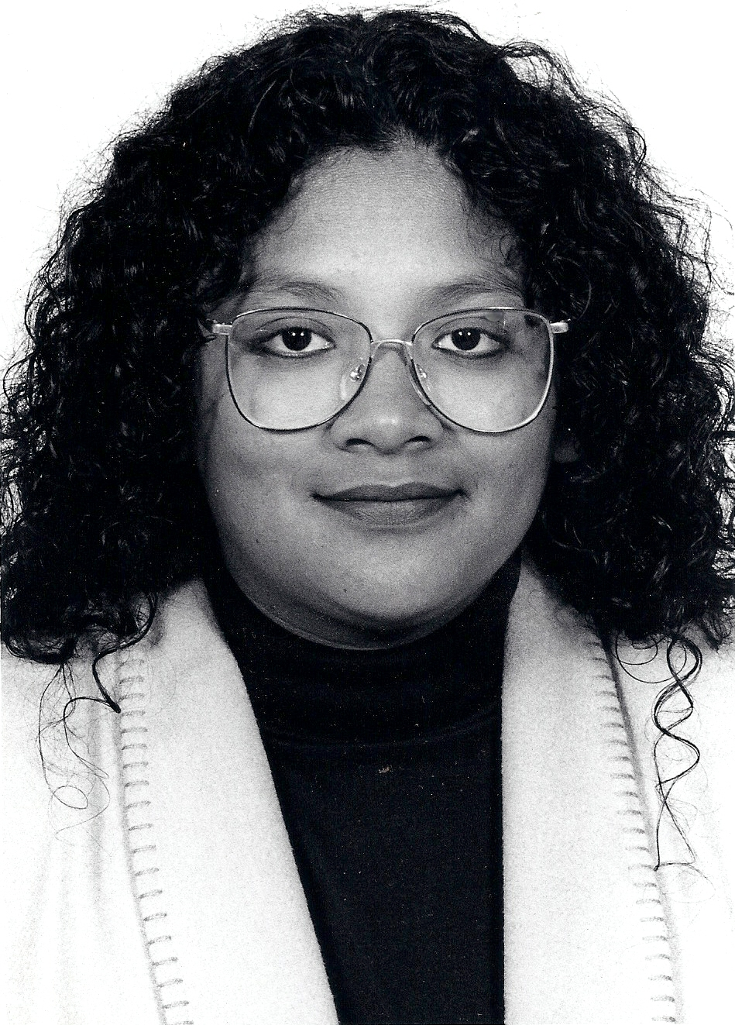
Student of Note - 1995

Slide 9
On Course
By Skip Downing

Slide 10
Pre & Post: Luke Wolske
Area | Pre Score | Post Score
Personal Responsibility | 52 | 75
Self-Motivation | 27 | 75
Self-Management | 38 | 50
Interdependence | 38 | 51
Self Awareness | 42 | 69
Lifelong Learning | 33 | 73
Emotional Intelligence | 38 | 61
Believe | 58 | 75

Slide 11
… and I am responsible.

Slide 12
Extended Opportunity Programs & Services
Summer Institute Program

Slide 13
English 105/106/107 – College Reading
Improve reading comprehension
Develop academic vocabulary
Master effective reading strategies
Raise reading rate
Increase reading endurance
Explore skills of efficiency
Broaden general background knowledge

Slide 14
English 105 – Data Outcomes
ENGL-105 Pre- and Post-Test Results for SIP Participants
 | Number of Students |  | Average Score (Grade Level)
Reading Comprehension: average score increased 1.8 grade levels (28% increase)
Pre | 63 | 6.5
Post | 63 | 8.3
Vocabulary: average score increased 1.0 grade levels (13% increase)
Pre | 63 | 7.5
Post | 63 | 8.5
Total: average score increased 1.4 grade levels (20% increase)
Pre | 63 | 7.0
Post | 63 | 8.4

Slide 15
Extended Opportunity Programs & Services
Summer Institute Program

Slide 16
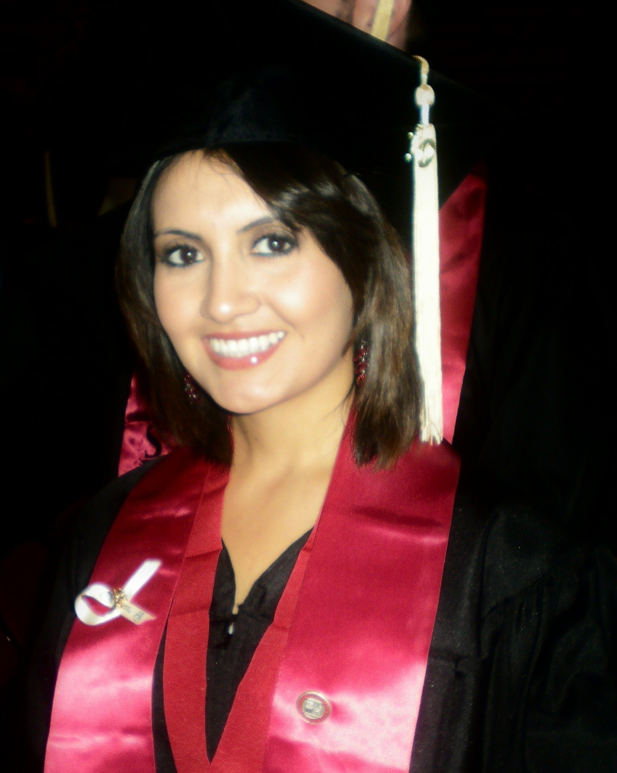
Grossmont Class of 2007 SDSU Class of 2010
SIP Class of 2004

Slide 17
Extended Opportunity Programs & Services
Summer Institute Program

Slide 18
Persistence

Slide 19
Persistence
First-Year Students, Fall to Spring

Slide 20
Persistence
First-Year Students, Fall to Spring
72%

Slide 21
Persistence
Summer Institute Students

Slide 22
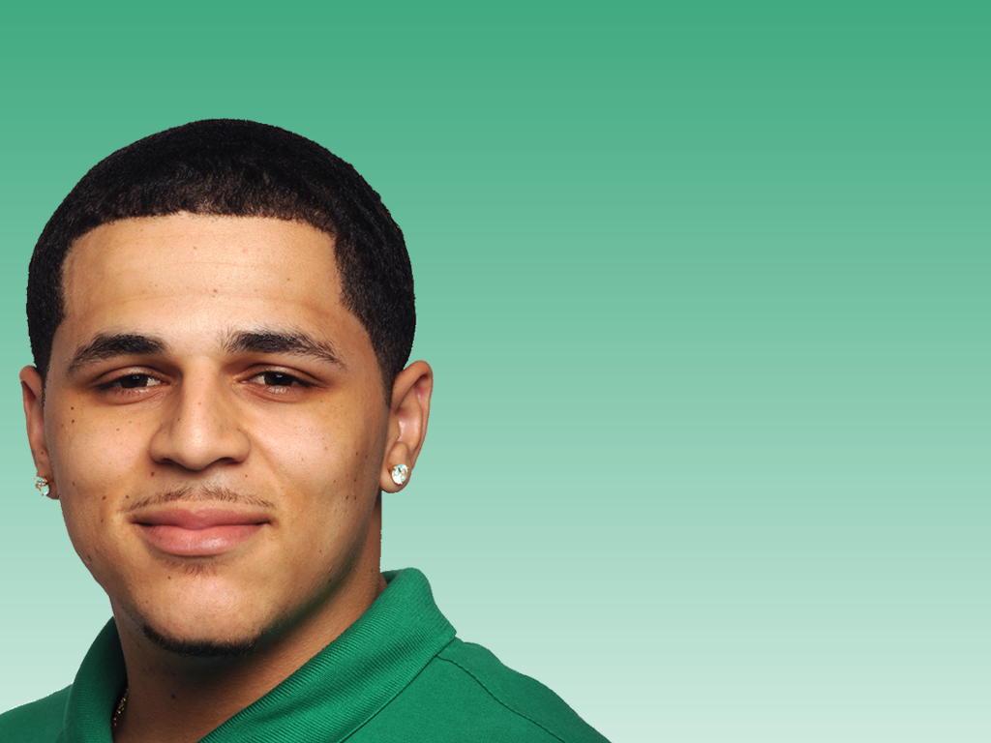
Persistence
Summer Institute Students
91%
Mauricio Delgado, Psychology

Slide 23
Extended Opportunity Programs & Services
Summer Institute Program

Slide 24
First-Year Experience Pilot
FALL 2010
COHORT 1 and 2
English 90
English 90R
PDC 110
SPRING 2011
COHORT 1 and 2
English 98
English 98R
Math 88
PDC 130
SUMMER 2010
Summer Institute Program
COHORT 1 – 4
English 105
PDC 120
FALL 2010
COHORT 3 and 4
English 98
English 98R
PDC 110
SPRING 2011
COHORT 3 and 4
English 110
English 110R
Math 90
PDC 130

Slide 25
FYE Services
Priority Registration
School Supplies
Weekly lunch stipend
Additional tutoring
Transportation assistance
In-class tutors
Licensed Therapist
Life Coach
Study Jam sessions
University Field Trips
Career guest speakers
Luncheons
Career-Themed Courses

Slide 26
Please take this home with you…
SIP transforms student legacies.
SIP builds persistence.
SIP models future success for the entire campus.

Slide 27
Questions?

